Slide 1

COST- Unit 5
Exponential Curve Fitting

Slide 2
Revision
Curve fitting
Method of least squares
Least square line
Least square parabola

Slide 3
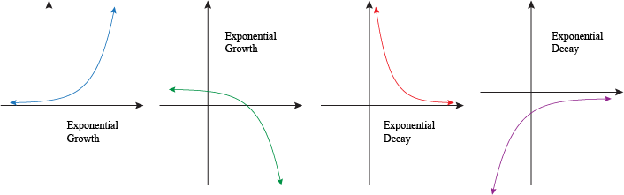
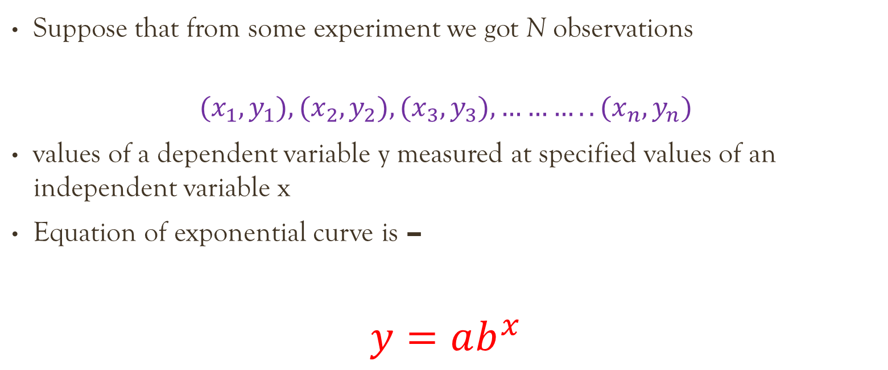
Exponential curve
Suppose that from some experiment we got N observations
$${(x}_{1},y_{1}), {(x}_{2},y_{2}), {(x}_{3},y_{3}), ………..{(x}_{n},y_{n})$$
values of a dependent variable y measured at specified values of an independent variable x
Equation of exponential curve is –
$$y=ab^{x}$$

Slide 4
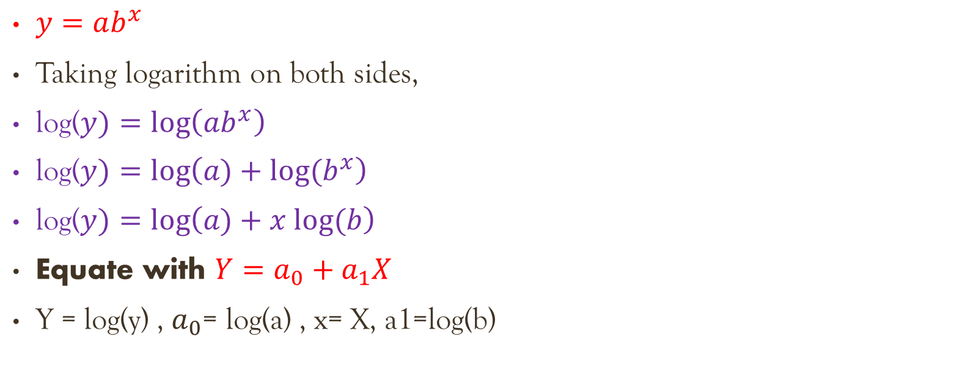
Converting exponential function to linear form
$y=ab^{x}$
Taking logarithm on both sides,
log($y)=\log\left(ab^{x}\right)$
log($y)=\log\left(a)+log⁡(b^{x}\right)$
log($y)=\log\left(a)+x log⁡(b\right)$
Equate with $Y=a_{0}+a_{1}X$
Y = log(y) , $a_{0}$= log(a) , x= X, a1=log(b)

Slide 5

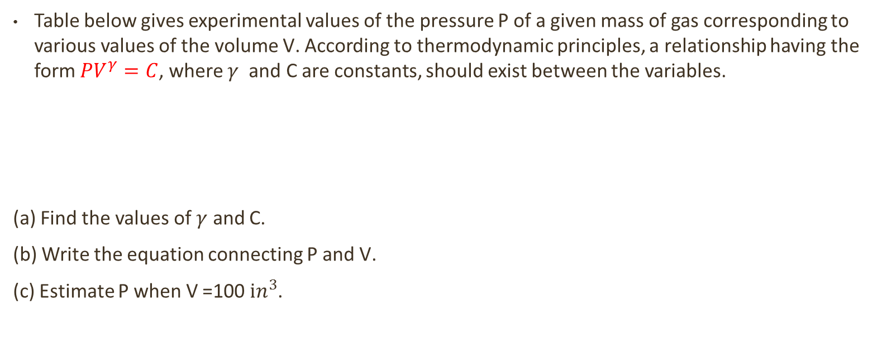
Question
Table below gives experimental values of the pressure P of a given mass of gas corresponding to various values of the volume V. According to thermodynamic principles, a relationship having the form $PV^{γ}=C$, where $γ$ and C are constants, should exist between the variables.
(a) Find the values of $γ$ and C.
(b) Write the equation connecting P and V.
(c) Estimate P when V =100 $ⅈn^{3}$.

Slide 6

Solution
$PV^{γ}=C$
Taking log on both sides
log($PV^{γ})=log⁡(C$)
log($P)+γ log⁡(V)=log⁡(C$)
Rearranging terms,
$log⁡(P$)= log($C)−γ log⁡(V)$
Comparing with $Y=a_{0}+a_{1}X$
X = log(V) , Y = log(P), $a_{0}$= log(C) , $a_{1}$= $−γ$

Slide 7
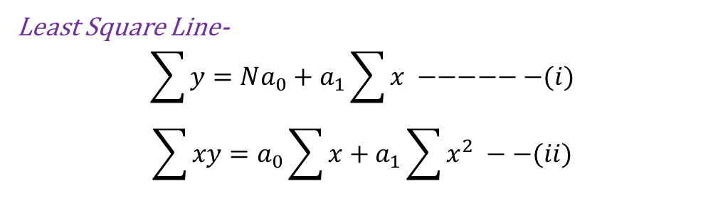
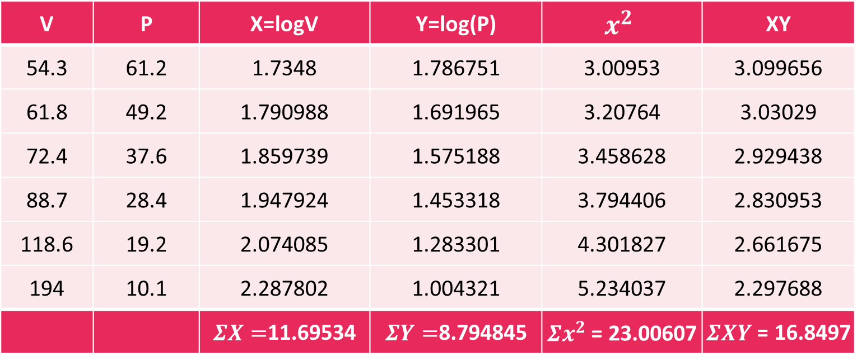
Cont..
Least Square Line-
$$\sum{y}=Na_{0}+a_{1}\sum{x} −−−−−−(i)$$
$$\sum{xy}=a_{0}\sum{x}+a_{1}\sum{x^{2}} −−(ii)$$
V | P | X=logV | Y=log(P) | $$x^{2}$$ | XY
54.3 | 61.2 | 1.7348 | 1.786751 | 3.00953 | 3.099656
61.8 | 49.2 | 1.790988 | 1.691965 | 3.20764 | 3.03029
72.4 | 37.6 | 1.859739 | 1.575188 | 3.458628 | 2.929438
88.7 | 28.4 | 1.947924 | 1.453318 | 3.794406 | 2.830953
118.6 | 19.2 | 2.074085 | 1.283301 | 4.301827 | 2.661675
194 | 10.1 | 2.287802 | 1.004321 | 5.234037 | 2.297688
 |  | $ΣX=$11.69534 | $ΣY=$8.794845 | $Σx^{2}$ = 23.00607 | $ΣXY$ = 16.8497

Slide 8
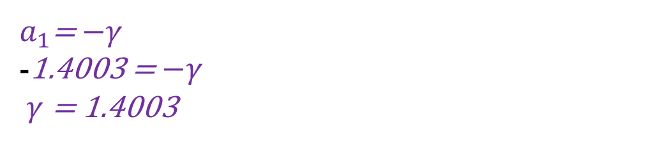
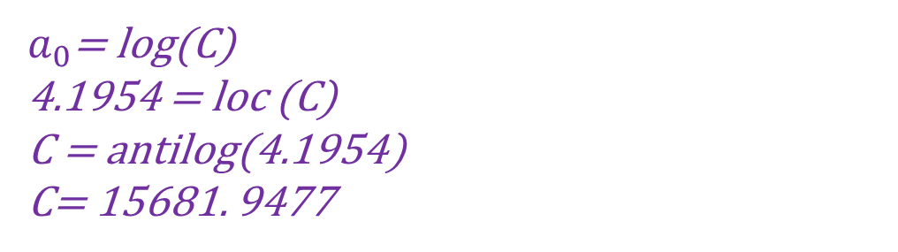
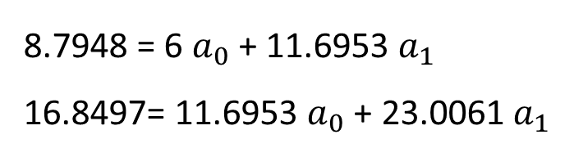
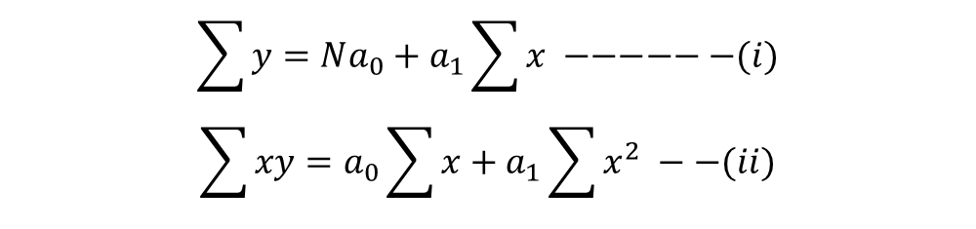
Cont..
$$\sum{y}=Na_{0}+a_{1}\sum{x} −−−−−−(i)$$
$$\sum{xy}=a_{0}\sum{x}+a_{1}\sum{x^{2}} −−(ii)$$
$ΣX=$11.69534 | $ΣY=$8.794845 | $Σx^{2}$ = 23.00607 | $ΣXY$ = 16.8497
8.7948 = 6 $a_{0}$ + 11.6953 $a_{1}$
16.8497= 11.6953 $a_{0}$ + 23.0061 $a_{1}$
$a_{0}$ = 4.1954
a. Find the values of $γ$ and C.
$a_{1}$= - 1.4003
$a_{0}$= log(C)
4.1954 = loc (C)
C = antilog(4.1954)
C= 15681. 9477
$a_{1}$= $−γ$
-1.4003 = $−γ$
$γ$ = 1.4003

Slide 9
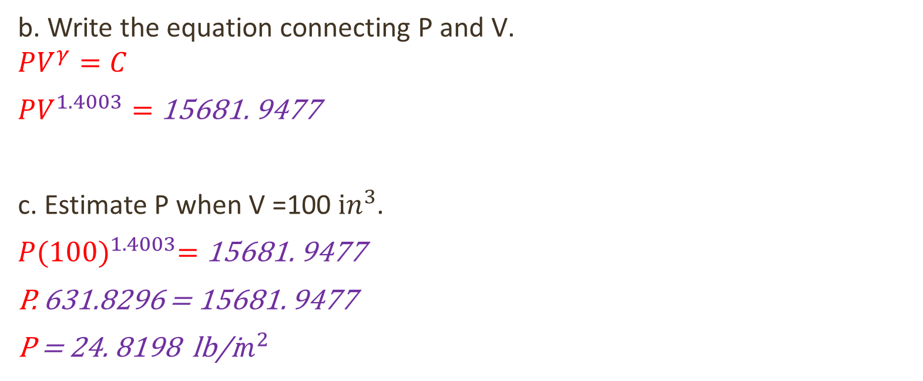
Cont ..
b. Write the equation connecting P and V.
$$PV^{γ}=C$$
$PV^{1.4003}=$ 15681. 9477
c. Estimate P when V =100 $ⅈn^{3}$.
$P{(100)}^{1.4003}=$ 15681. 9477
P. 631.8296 = 15681. 9477
P = 24. 8198 lb/i$n^{2}$

Slide 10
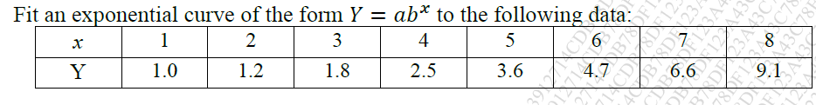

Question
$$y=ab^{x}$$
Taking logarithm on both sides,
log($y)=\log\left(ab^{x}\right)$
log($y)=\log\left(a)+log⁡(b^{x}\right)$
log($y)=\log\left(a)+x log⁡(b\right)$
Equate with $Y=a_{0}+a_{1}X$
Y = log(y) , $a_{0}$= log(a) , x= X, a1=log(b)

Slide 11

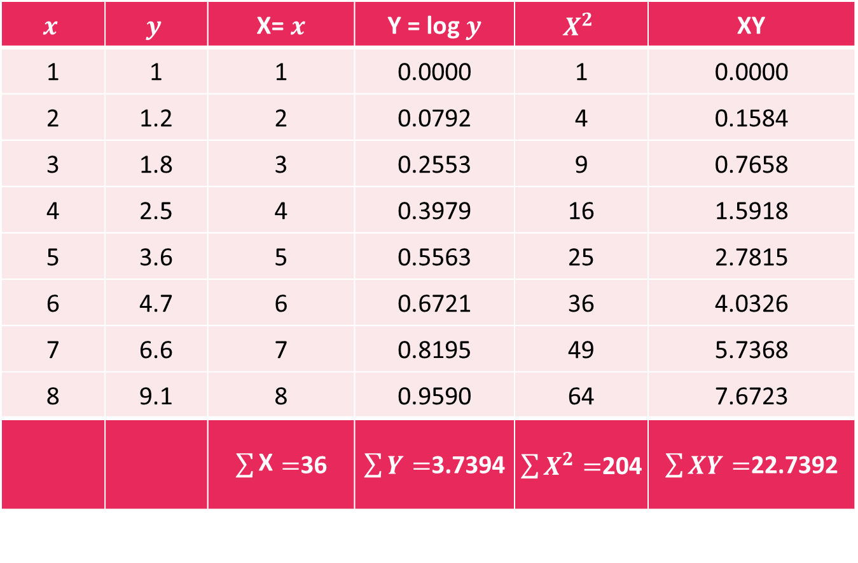
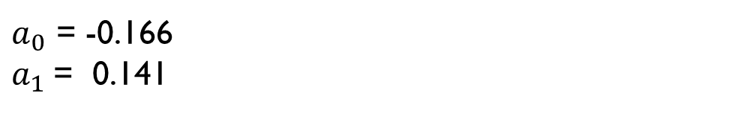

Cont. ..
$$x$$ | $$y$$ | X= $x$ | Y = log $y$ | $$X^{2}$$ | XY
1 | 1 | 1 | 0.0000 | 1 | 0.0000
2 | 1.2 | 2 | 0.0792 | 4 | 0.1584
3 | 1.8 | 3 | 0.2553 | 9 | 0.7658
4 | 2.5 | 4 | 0.3979 | 16 | 1.5918
5 | 3.6 | 5 | 0.5563 | 25 | 2.7815
6 | 4.7 | 6 | 0.6721 | 36 | 4.0326
7 | 6.6 | 7 | 0.8195 | 49 | 5.7368
8 | 9.1 | 8 | 0.9590 | 64 | 7.6723
 |  | $\sum{\text{X}}=$36 | $\sum{Y}=$3.7394 | $\sum{X^{2}}=$204 | $\sum{XY}=$22.7392
3.7394= 8 $a_{0}$ + 36 $a_{1}$
22.7392= 36 $a_{0}$ + 204 $a_{1}$
$a_{0}$ = -0.166
$a_{1}$= 0.141

Slide 12
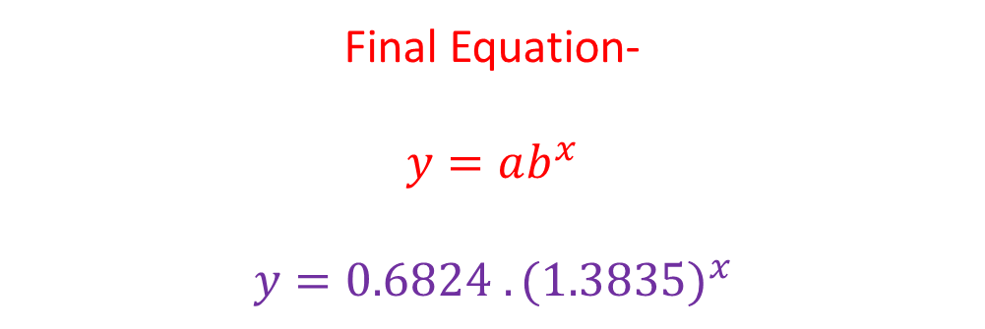

Cont. ..
$a_{0}$ = -0.166 , $a_{1}$= 0.141
$a_{0}$= log(a)
-0.166 = log(a)
a = antilog(-0.166) = 0.6824
a1=log(b)
0.141 = log(b)
b = antilog(1.141) = 1.3835
Final Equation-
$$y=ab^{x}$$
$$y=0.6824 {.(1.3835)}^{x}$$

